Slide 1
10th Annual NIIM Symposium:
For Healthcare Practitioners
Sponsorship Prospectus
Thursday 11th & Friday 12th September 2025
Amora Riverwalk Hotel, Richmond, VIC

Slide 2
Join us at the 10th Annual NIIM Symposium
We are delighted to announce the 10th Annual NIIM Symposium is scheduled for
Thursday 11 and Friday 12 September 2025!
The program is designed for GPs, medical specialists, healthcare practitioners, allied and complementary clinicians, pharmacists, psychologists, acupuncturists, nurses, researchers, academics, naturopaths, herbalists, healthcare and medical students and others involved in the healthcare industry.
NIIM is committed to bringing together leading keynote speakers, professors and researchers in this multi-disciplinary area of medicine. The sessions will focus on presenting the latest evidence, practical experience and research findings on a variety of topics.
The extensive program will cover the diverse challenges and opportunities facing various streams of Integrative Medicine, innovative therapies and treatments for the prevention, detection and treatment of disease. Keynote speakers will also cover lifestyle, nutritional and environmental factors impacting health and wellness.
Empowering people to take control of their health

Slide 3
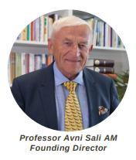
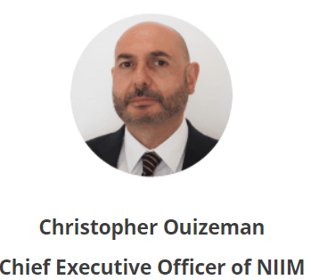
About the National Institute of Integrative Medicine (NIIM)
NIIM was established by Professor Avni Sali AM in 2005 with the help of community supporters. NIIM brings together the education, research and practice of Integrative Medicine (IM), and to further its use and understanding within the general and medical community.
NIIM’s activities and focus areas include:
Educating healthcare professionals and the general public regarding the benefits of IM
Conducting research into IM treatments and technologies
Raising awareness of the role of IM in medical practices and public health
Providing community access to holistic healthcare with qualified and expert IM practitioners
NIIM works collaboratively with a network of national and international partners and is dedicated to establishing effective healthcare treatments and technologies backed by evidence and rigorous scientific testing. These innovations increase diagnostic screening and treatment options for patients with chronic illnesses and can significantly improve patient outcomes. The NIIM clinic in Melbourne along with the Dispensary, provides the community with access to IM GPs, allied and complementary health professionals, innovative therapies and an in-house Dispensary.

Slide 4
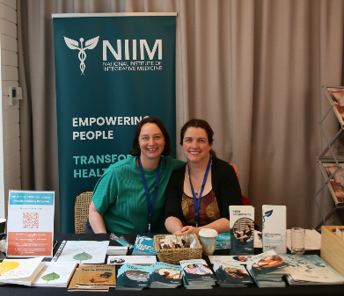
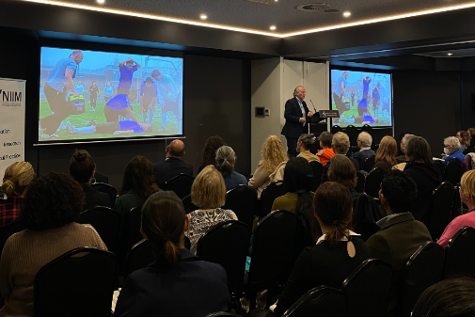
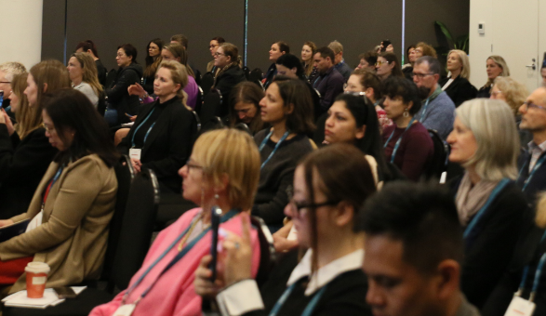
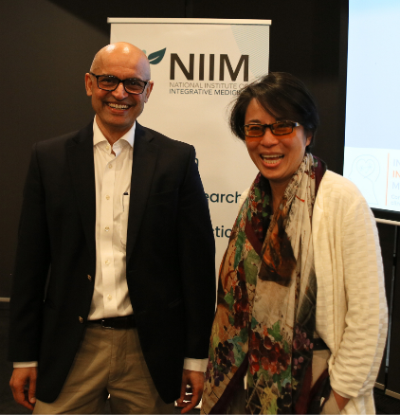
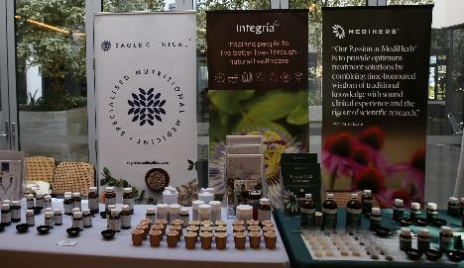
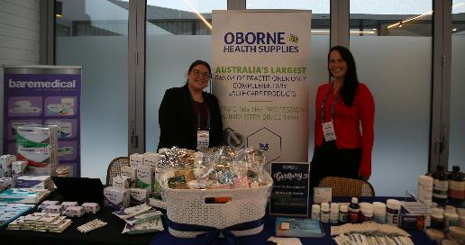
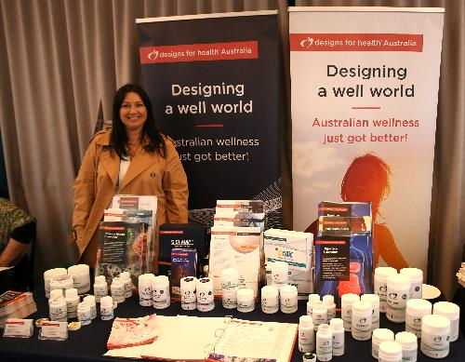
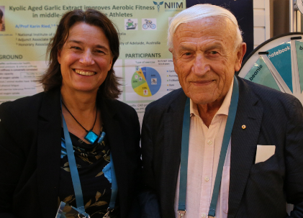
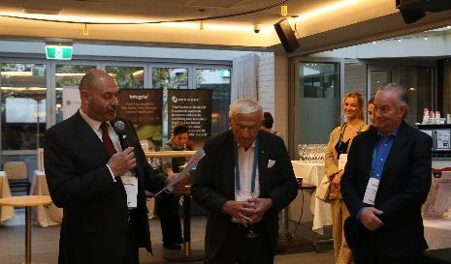
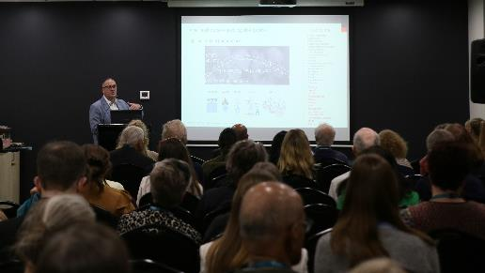
Highlights & Recap – 9th Annual NIIM Symposium in 2024

Slide 5
Highlights & Recap – 9th Annual NIIM Symposium
The results of the 2024 Symposium speak for themselves, with a great attendance rate and return on investment for our sponsors, and meaningful education delivered for delegates:
150+ delegates attended
18+ hours of presentations and workshops delivered
Overall positive rating of 9.15/10 from delegates
24 expert keynote speakers comprised of professors, researchers, doctors and healthcare professionals
6+ hours for delegates to visit exhibition area
Some positive feedback from our sponsors and delegates:
“An excellent event, we will be back next year!”
“This has been one of the best events of 2024!”
“We always look forward to NIIM events every year, it’s such a great addition to our business.”
“Thank you for such a great conference. I thought the diversity of speakers and topics were great and so many speakers were engaging and informative!”

Slide 6
Top Reasons to Sponsor the 10th Annual NIIM Symposium
Direct Access to Healthcare Professionals: Connect with an audience of approx. 200 highly skilled medical and allied health practitioners who influence healthcare decisions and patient care in the field of integrative and complementary medicine. Our audience of healthcare professionals are actively seeking innovative solutions, tools, education and products to enhance their clinical practice.
Positioning as a Leader in Healthcare Innovation: Align your brand with the forefront of integrative and complementary medicine, reinforcing your commitment to advancing healthcare practices and improving patient outcomes. Align with NIIM’s reputation for integrity and excellence in education and healthcare, boosting trust in your brand among an audience that values credibility.
Networking with Decision-Makers and Influencers: Engage directly with integrative medicine industry thought leaders, researchers, and practitioners who influence purchasing decisions and drive innovation in healthcare. Establish connections that extend beyond the event, creating opportunities for ongoing collaborations and partnerships with practitioners and organizations.
Involvement in Cutting-Edge Medical Education: Support a program presenting the latest evidence-based research, clinical insights, and practical strategies in integrative medicine, healthy aging, and lifestyle interventions.
Customized Sponsorship Packages: Choose from tailored sponsorship options that maximize your return on investment, from brand visibility in conference materials and promotions to exclusive speaking opportunities.
Enhanced Digital Reach: Benefit from pre- and post-event promotion across NIIM’s extensive digital channels, including our extensive database, thousands of followers on social media, newsletters, and website features, amplifying your brand’s reach to an even wider audience.
Access to New Market Insights: Gain a deeper understanding of the challenges, opportunities, and trends in the medical and allied health fields through interaction with delegates and speakers.

Slide 7
Schedule: Day 1 – 11-09-2025
Session | Time | Minutes | Description | Presenter/Speaker
Arrival | 8.15am - 8.45am | 30 mins | Registration - Arrival Tea & Coffee
Session 1 | 8.45 - 9.00 | 15 mins | Welcome & official opening | NIIM CEO (Christopher Ouizeman) & MC
 | 9.00 - 9.40 | 40 mins | Speaker 1 - Keynote (B&Y room) | Prof AVNI SALI AM
 | 9.40 - 10.20 | 40 mins | Speaker 2 - Keynote (B&Y room) | Speaker TBC
 | 10.20 - 10.30 | 10 mins | Interactive Q&A Panel - facilitated by MC
 | 10.30am - 11am | 30 mins | Morning Tea - Exhibition & Poster Viewing (30mins)
Session 2 | 11.00 - 11.40 | 40 mins | Speaker 3 - Keynote | Speaker TBC
 | 11.40 - 12.20 | 40 mins | Speaker 4 - Keynote | Speaker TBC
 | 12.20 - 12.30 | 10 mins | Interactive Q&A Panel - facilitated by MC
 | 12.30pm - 1.30pm | 60 mins | Lunch - Exhibition & Poster Viewing (1 hr)
Session 3 - Concurrent Workshops | 1.30 - 2.10 | 40 mins | Speaker 5 - TBC - B&Y room | Speaker 6 - TBC - Hawthorn Room | Speaker 7 - Wellness Session with TBC (Banks Room)
 | 2.10 - 2.15 | 5 mins | Changeover time (5 mins)
 | 2.15 - 2.55 | 40 mins | Speaker 8 - TBC B&Y Room | Speaker 9 -TBC - Hawthorn room | Speaker 10 – ABSTRACT session (Banks Room)
 | 2.55pm - 3.30pm | 35 mins | Afternoon Tea - Exhibition & Poster Viewing (35mins)
Session 4 | 3.30 - 4.10 | 40 mins | Speaker 11 - Keynote - TBC
 | 4.10 - 4.50 | 40 mins | Speaker 12 - Keynote - TBC
 | 4.50 - 5.00 | 10 mins | Interactive Q&A Panel - facilitated by MC
 | 5.00 - 5.15 | 15 mins | BUFFER to allow for any sessions running overtime
 | 5.15 - 7.30 | 120 mins | Networking function - Finger food & drinks (Day 1 only)
Please note, this schedule is a draft only, it is correct at the time of distribution and is subject to change.

Slide 8
Schedule: Day 2 – 12-09-2025
Session | Time | Minutes | Description | Presenter/Speaker
Arrival | 8.15am - 8.45am | 30 mins | Registration - Arrival Tea & Coffee | -
Session 5 | 8.45 - 9.00 | 15 mins | Welcome & official opening | NIIM CEO (Christopher Ouizeman) & MC
 | 9.00 - 9.40 | 40 mins | Speaker 1 Keynote (B&Y room) | TBC
 | 9.40 - 10.20 | 40 mins | Speaker 2 Keynote (B&Y room) | TBC
 | 10.20 - 10.30 | 10 mins | Interactive Q&A Panel - facilitated by MC
 | 10.30am - 11am | 30 mins | Morning Tea - Exhibition & Poster Viewing (30mins)
Session 6 | 11.00 - 11.40 | 40 mins | Speaker 3 - Keynote | TBC
 | 11.40 - 12.20 | 40 mins | Speaker 4 - Keynote | TBC
 | 12.20 - 12.30 | 10 mins | Interactive Q&A Panel - facilitated by MC
 | 12.30pm - 1.30pm | 60 mins | Lunch - Exhibition & Poster Viewing (1 hr)
Session 7 - Concurrent Workshops | 1.30 - 2.10 | 40 mins | Speaker 5 - TBC (B & Y Room) | Speaker 6 - TBC (Hawthorn Room) | Speaker 7 -TBC (Banks Room)
 | 2.10 - 2.15 | 5 mins | Changeover time (5 mins)
 | 2.15 - 2.55 | 40 mins | Speaker 8 - TBC (B & Y Room) | Speaker 9 - TBC (Hawthorn Room) | Speaker 10 - TBC (Banks Room)
 | 2.55pm - 3.30pm | 35 mins | Afternoon Tea - Exhibition & Poster Viewing (30mins)
Session 8 | 3.30 - 4.10 | 40 mins | Speaker 12 - Keynote - TBC
 | 4.10 - 4.50 | 40 mins | Speaker 12 - Keynote - TBC
 | 4.50 - 5.00 | 10 mins | Interactive Q&A Panel - facilitated by MC
Please note, this schedule is a draft only, it is correct at the time of distribution and is subject to change.

Slide 9
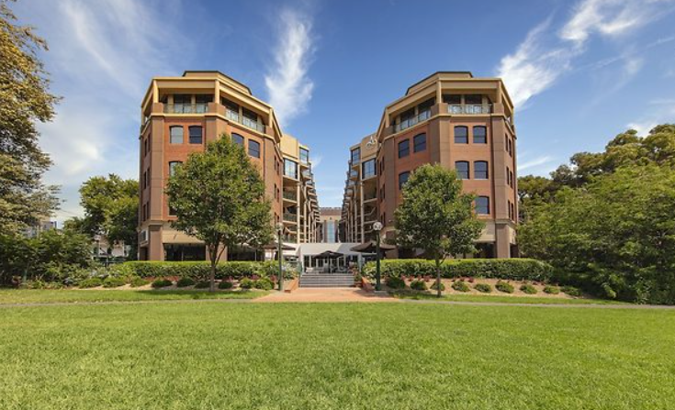
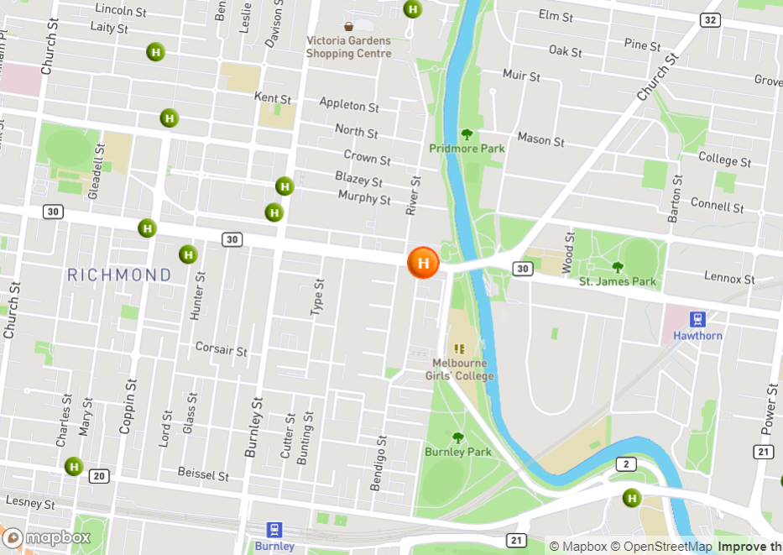
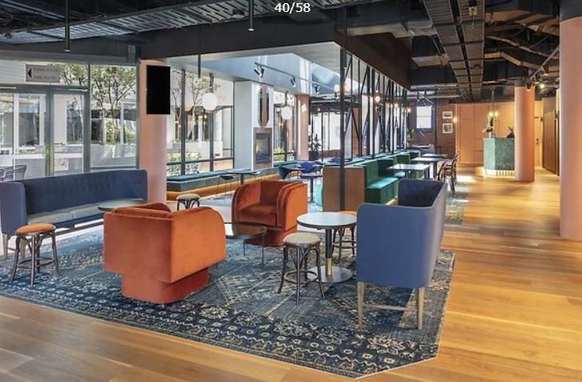
The Venue: Amora Riverwalk Hotel, Richmond
<<Enter venue location info, map, pic etc>>
Amora Riverwalk Hotel
649 Bridge Road Richmond VIC 3121
P: +613 9246 1200
W: www.amorahotels.com/amora-hotel-riverwalk-Melbourne

Slide 10
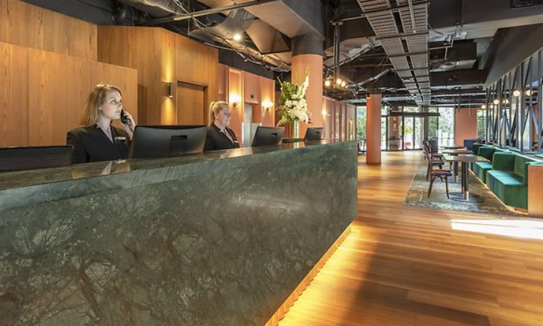
Floor Plan & Layout –
Meeting rooms for workshops & presentations
Main plenary room – Yarra + Bridge (combined)
This is the main presentation area with a seating capacity for up to 200 people (theatre style).
This will also be used as one of the breakout rooms.
Breakout room 1 – Hawthorn
This is one of 2 breakout rooms where workshops will take place with a seating capacity of up to 80 people (theatre style).
Breakout room 2 – Banks
This is one of 2 breakout rooms where workshops will take place with a seating capacity of up to 60 people (theatre style).

Slide 11
Nourish your mind & body:
Hospitality for our Sponsors and Delegates
Staying nourished and hydrated over two busy days is incredibly important for sponsors and delegates. Quality nutrition is one of the values NIIM stands by, and is one of the pillars of maintaining overall health.
We have worked closely with the Amora Riverwalk Hotel food and beverage team to develop a specially curated selection of beverages, wholesome meals and snacks to keep you energised and nourished throughout the day.
We will aim for as many menu items to be made gluten-free, with balanced levels of protein, healthy fats and carbohydrates. If you have any allergies or food intolerances, please ensure you advise us during the sponsorship application process.
Herbal teas, freshly brewed coffee, iced water and fresh-squeezed juices will be available throughout the day.
Morning tea, lunch and afternoon tea will be served buffet-style with meals for Sponsors being prioritised before delegates take their scheduled breaks.
The exhibition area overlooks beautifully manicured gardens with a spacious terrace and seating area, so please remember to enjoy the sunshine, fresh air and boost your Vitamin D.
We hope you enjoy the amazing amenities and environment that the Amora Hotel Riverwalk has to offer.

Slide 12
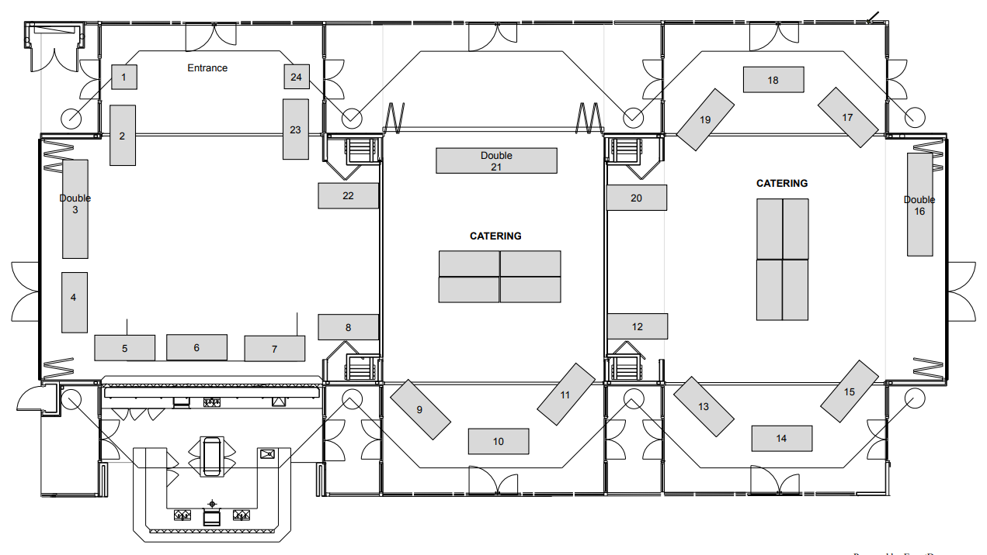
*Floor Plan & Layout – Exhibition Area
*Please note, this floor plan is a draft and correct at the time of distribution. It is subject to change.*

Slide 13
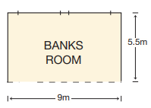
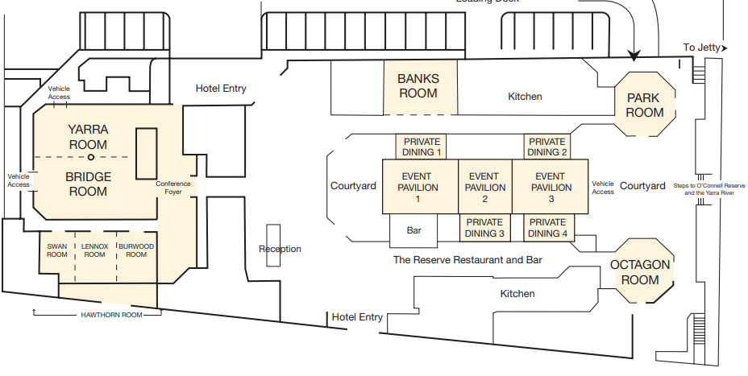
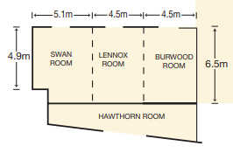
Floor Plan & Layout –
Meeting rooms for workshops & presentations
Main plenary room – Yarra + Bridge
Breakout room 1 – Hawthorn (Swan/Lennox/Burwood)
Breakout room 2 – Yarra + Bridge
Breakout room 3 – Banks
Exhibition area – Event Pavilion 1, 2 & 3

Slide 14
Contact Us
NIIM Events Team
E: events@niim.com.au

